Slide 1
Your Name Here

Slide 2
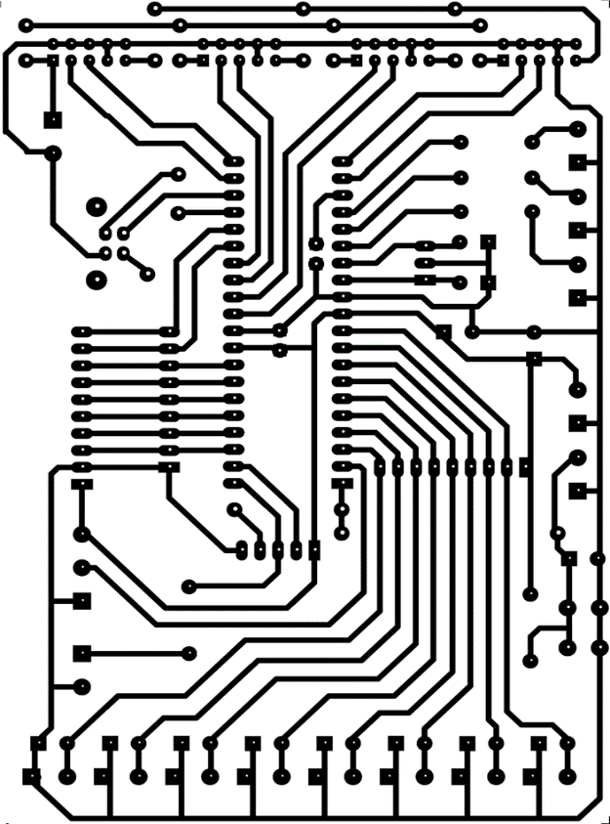







Inside My iPad Parts
How To Copy and Paste
1. Right click on an item on this page.
Click ‘Copy’.
Select Slide 1 (on the left).
Right click where you want it to go.
Click ‘Paste’
NOTE! Right click the border of the Text Boxes. Not inside the Text box.
Hard Drive
Processsor
Battery
Wifi
Microphone
Speakers
Motherboard
Memory

Slide 3








iPad Screen and Apps
How To Copy and Paste
1. Right click on an item on this page.
Click ‘Copy’.
Select Slide 1 (on the left).
Right click where you want it to go.
Click ‘Paste’.

